Slide 1
Exploring Generative Models: History, Speed, and Fine-Tuning

Slide 2
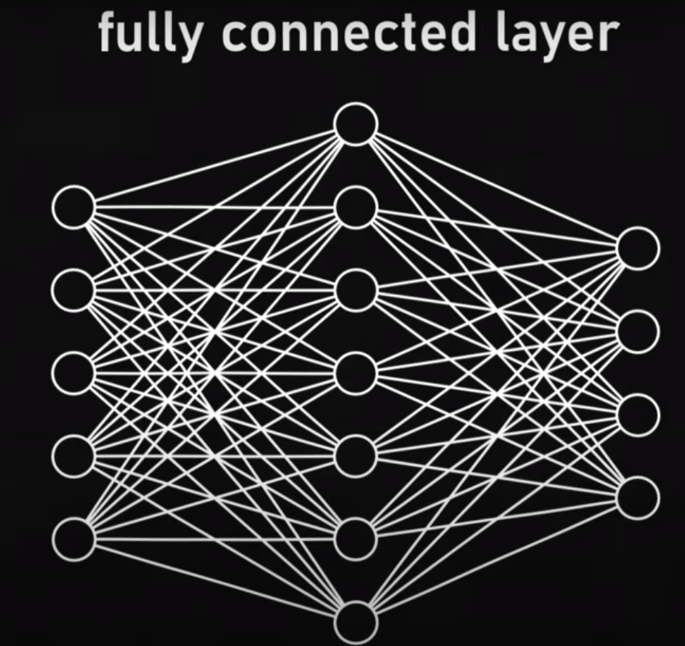
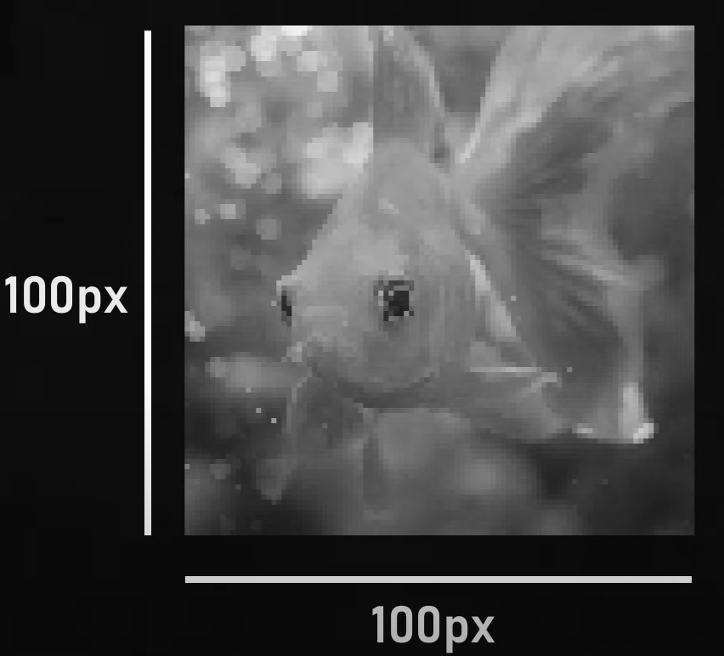

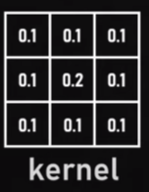
10,000
CNN
100,000,000

Slide 3
Computer vision

Slide 4
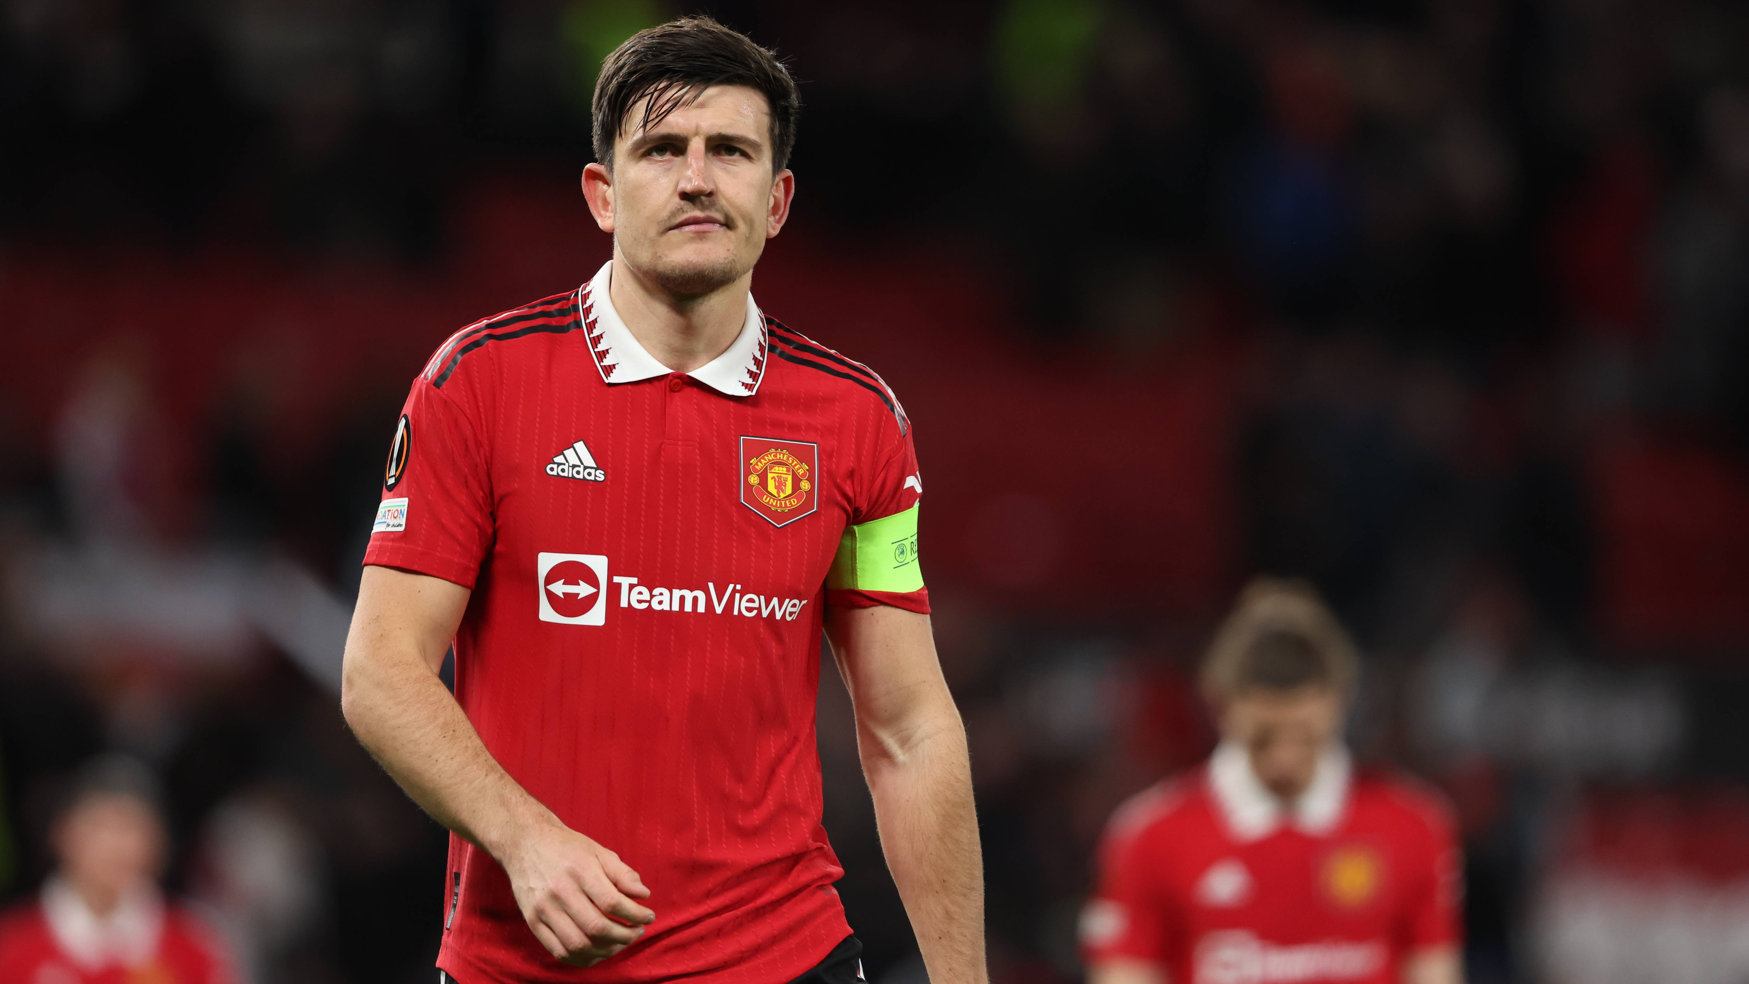
1: classification
VGG
ResNet
Inception
2014
2015
2015
Football Player

Slide 5
2: classification + lacalization
Football Player

Slide 6
3 : Object Detection
Yolo
RetinaNet
2015
2017
EfficientDet
2019
Object
Football Player
brace

Slide 7
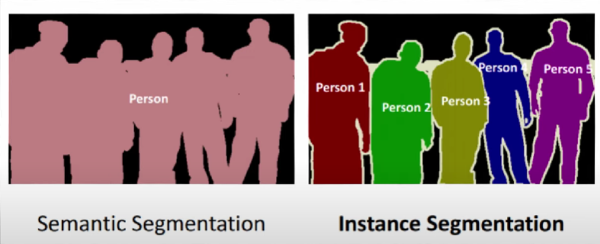
4 : Semantic/instance segmentation
Mask RCNN
2015
SAM
2023
Microsoft COCO
2014
ISBI cell tracking challenge 2015

Slide 8
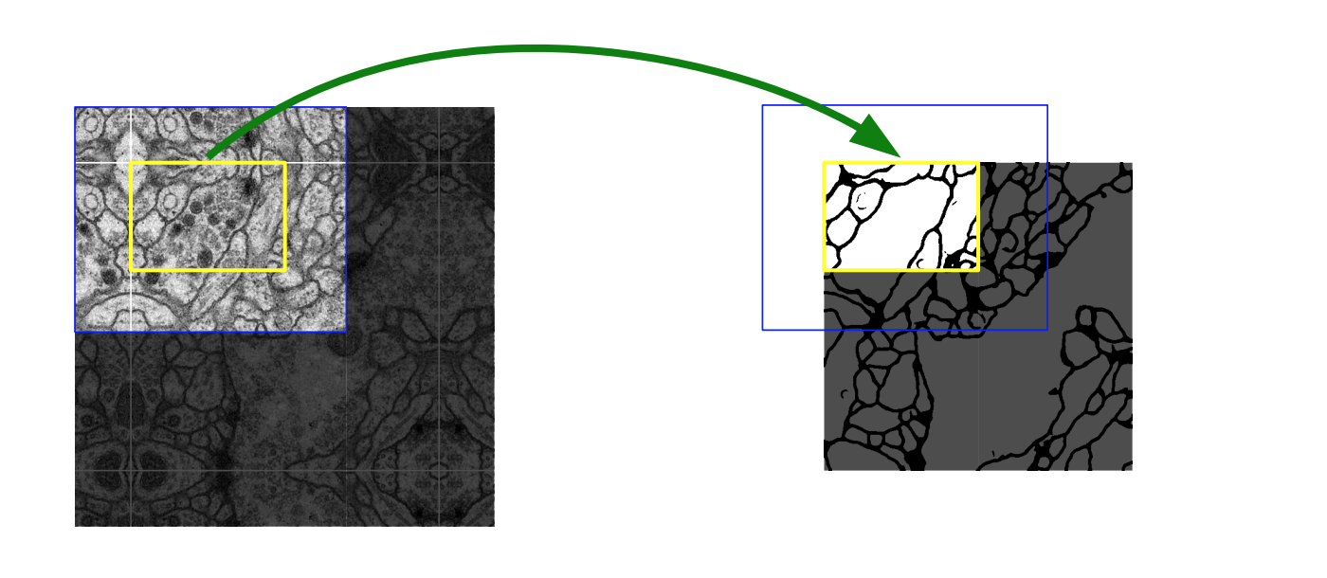
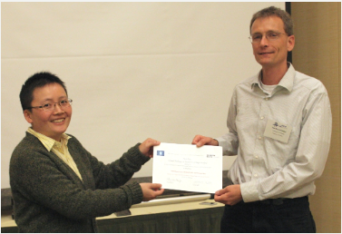
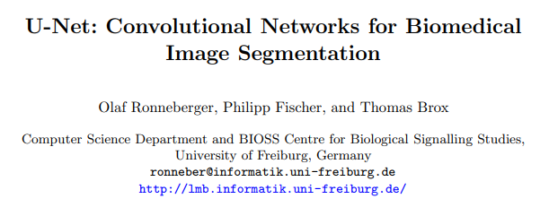
Unet

Slide 9
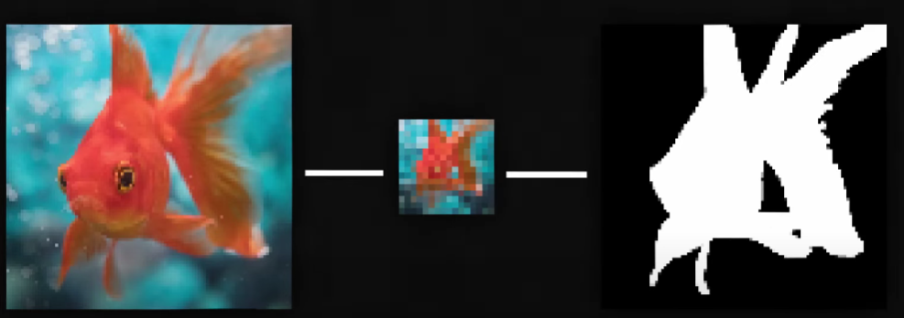

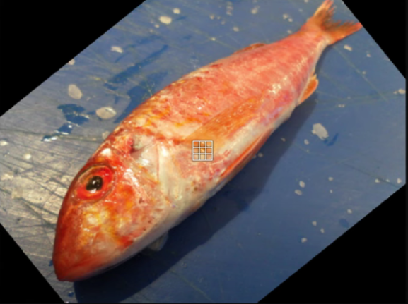
Principe

Slide 10
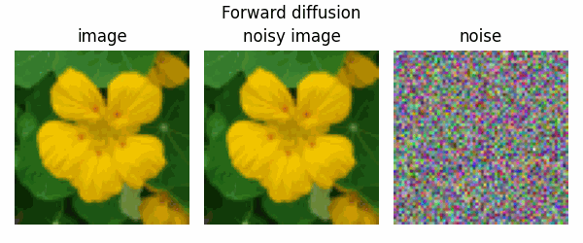
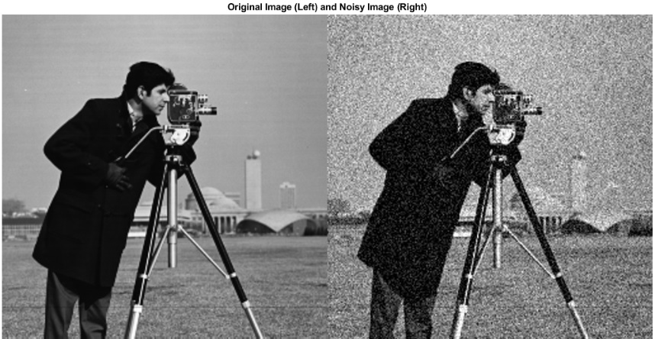
Denoising

Slide 11
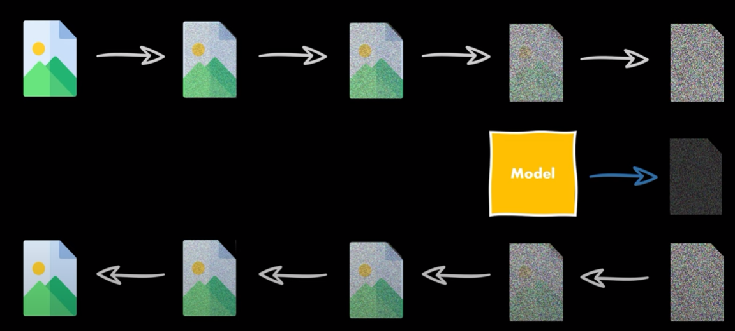
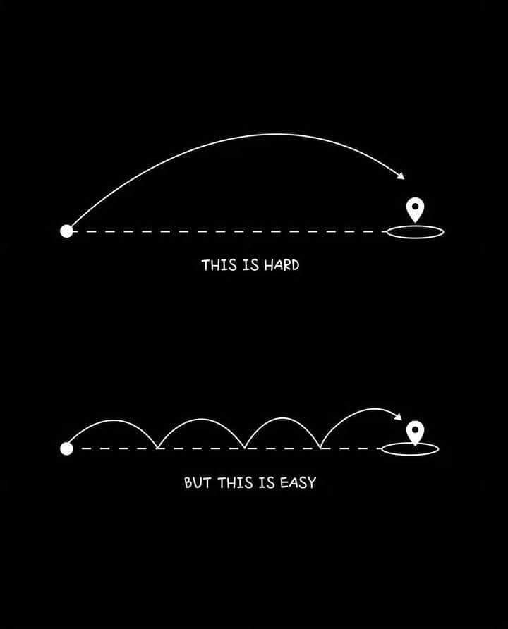
Diffusion models
t = n

Slide 12
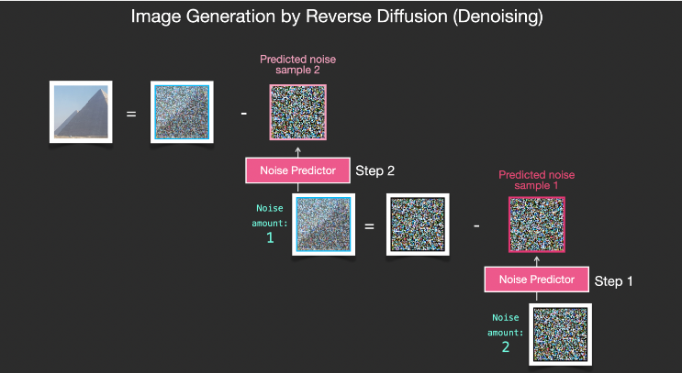

Slide 13
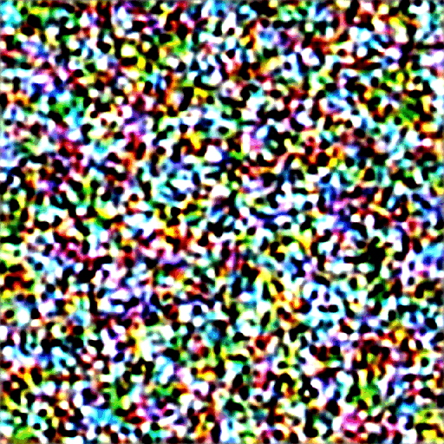

Slide 14
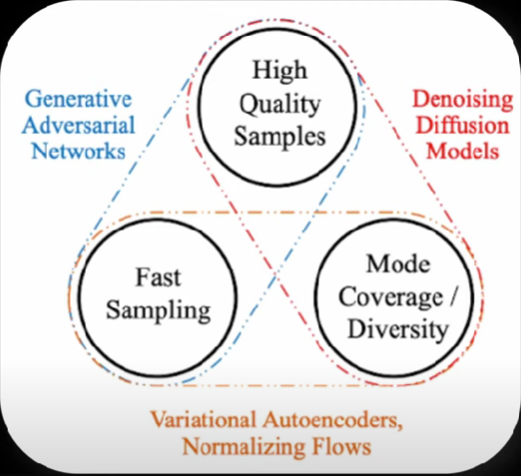
2020:

Slide 15
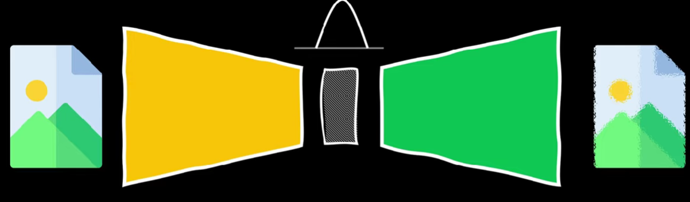
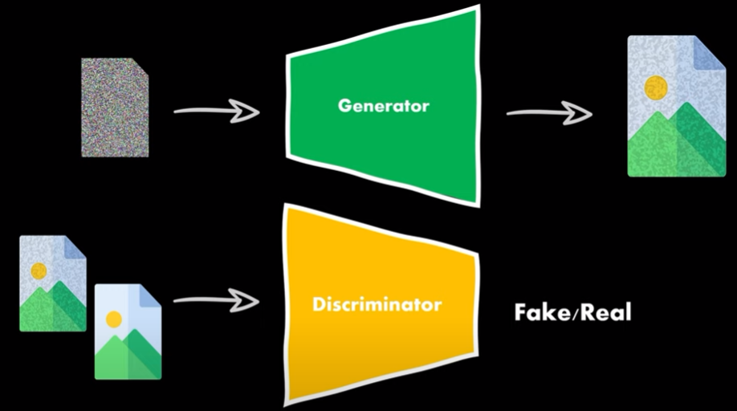
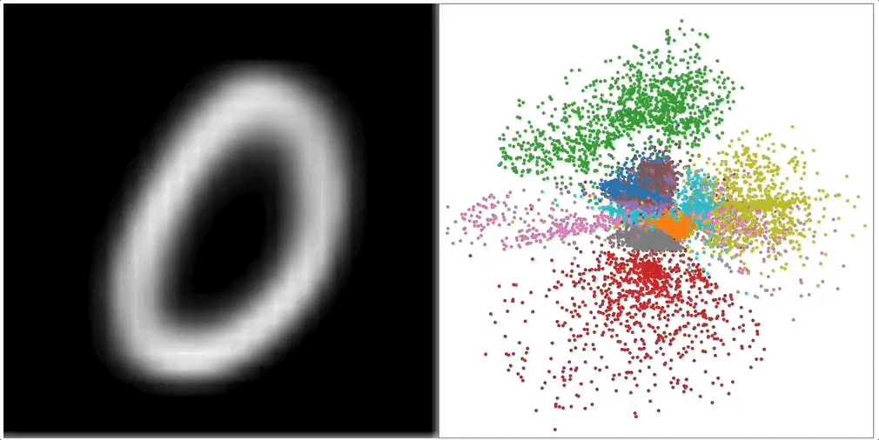
VAE
GAN

Slide 17
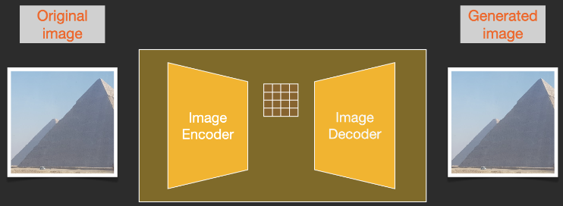
April 2022

Slide 18
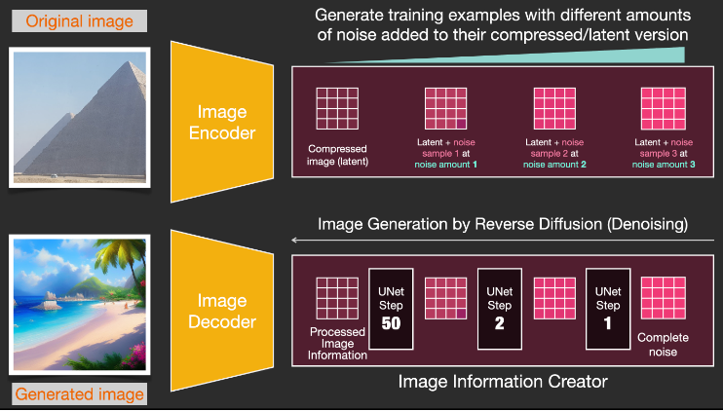

Slide 19
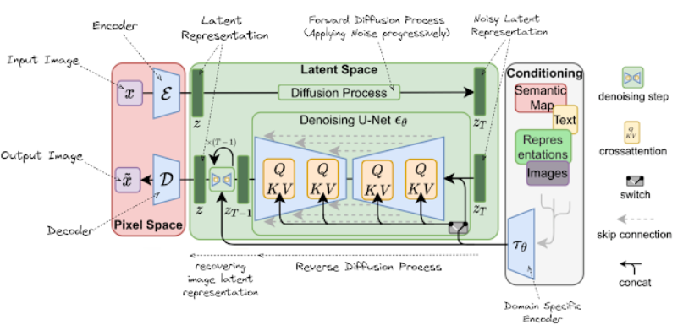

Slide 20
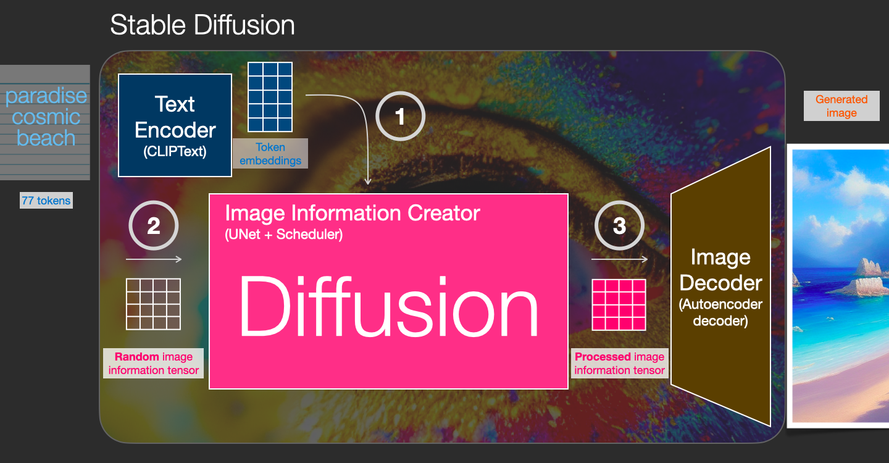

Slide 21
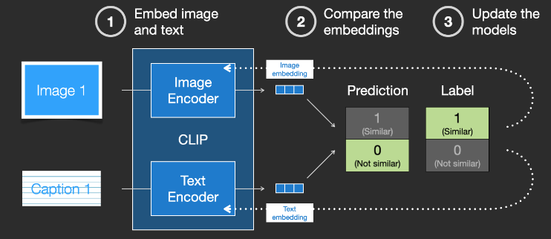
Clip

Slide 22
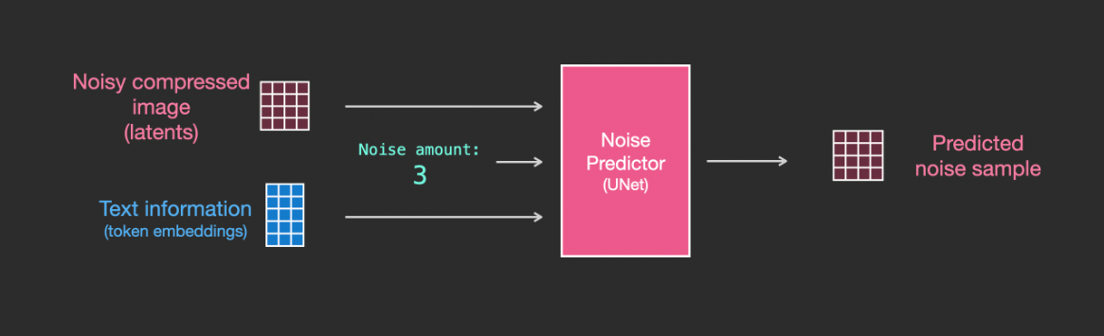
Image génération process

Slide 23
Fine tuning

Slide 24
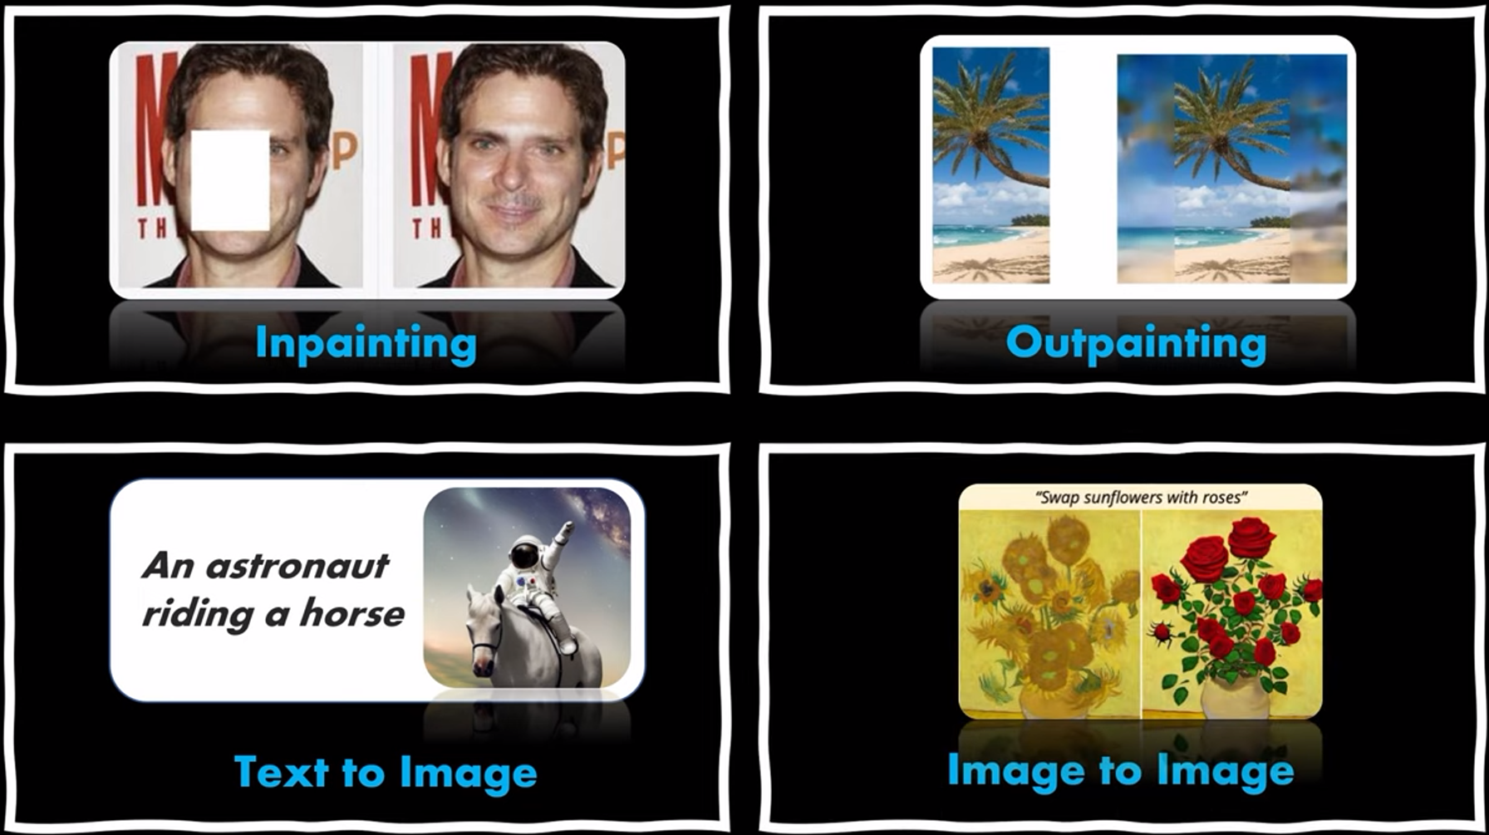
What we can do with SD?

Slide 25
Problems ?
Overfitting
Language drift
compute

Slide 26
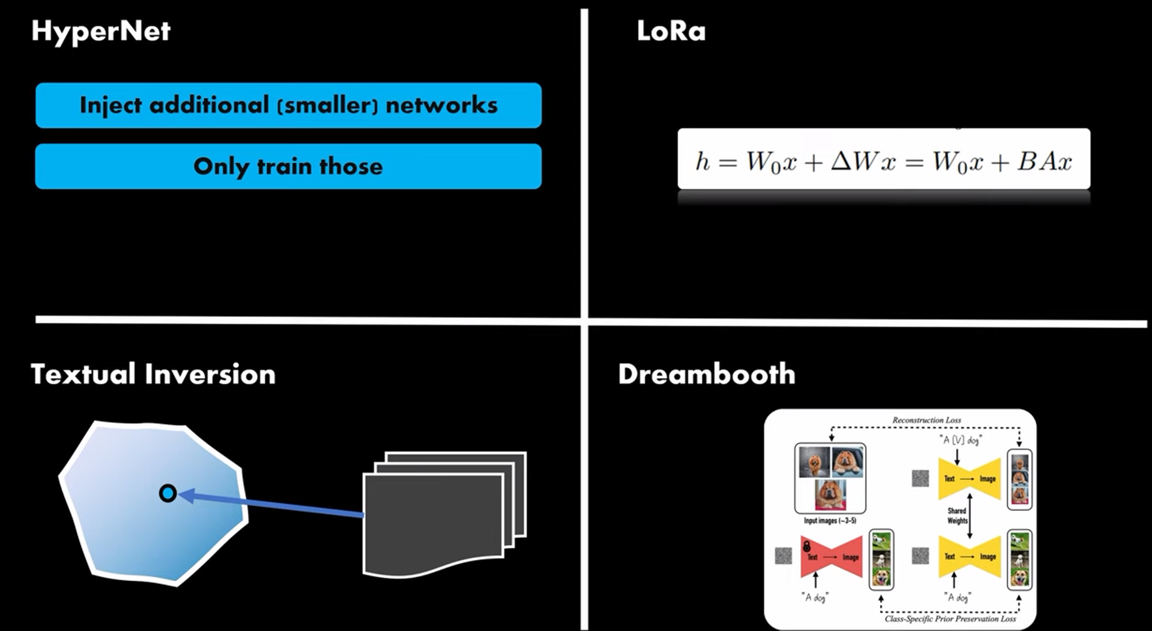
techniques
Microsoft 2020
An image is worth one word 2022
Mars 2023

Slide 27
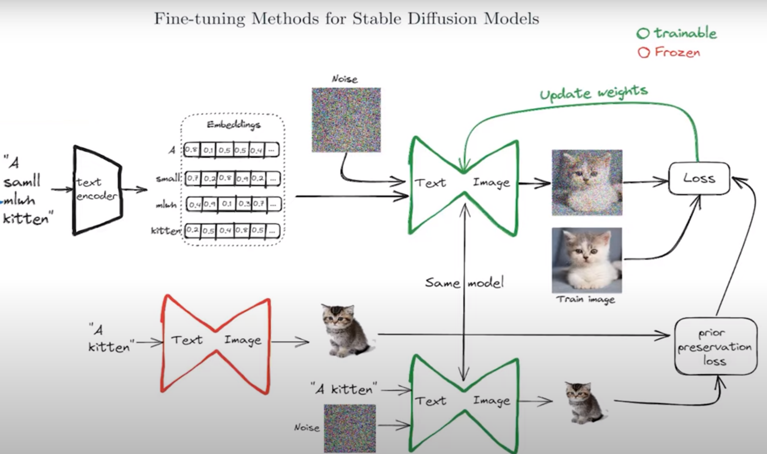
Dreambooth

Slide 28
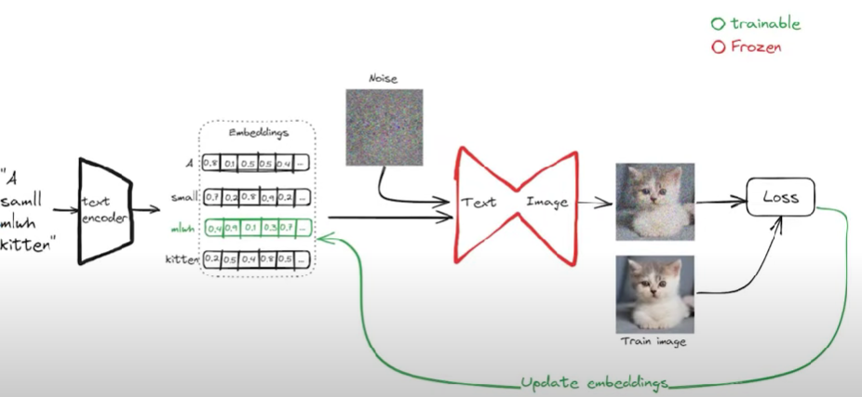
Textuel inversion

Slide 29
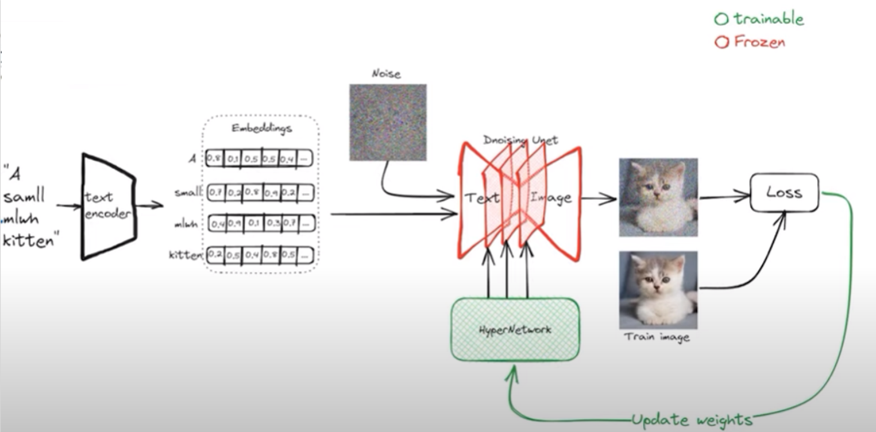
Hyper net

Slide 30
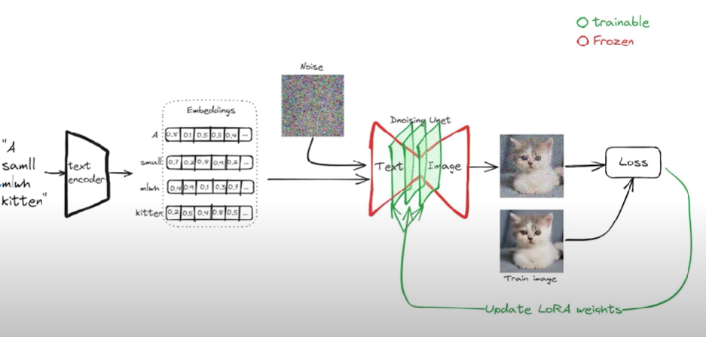
LORA

Slide 31
Thanks

Slide 32
Fine-tuning
https://github.com/LykosAI/StabilityMatrix
https://colab.research.google.com/github/KaliYuga-ai/DreamBoothV2fork/blob/main/DreamBooth_Stable_Diffusion_V2.ipynb
https://www.databricks.com/blog/efficient-fine-tuning-lora-guide-llms
https://huggingface.co/docs/peft/task_guides/dreambooth_lora
https://arxiv.org/abs/2208.12242
https://huggingface.co/docs/diffusers/training/text_inversion
https://arxiv.org/abs/2311.05556
https://arxiv.org/abs/2305.11147

Slide 33
Papers pre-2022
Mask R-CNN : https://arxiv.org/abs/1703.06870
LeNet5: https://medium.com/codex/lenet-5-complete-architecture-84c6d08215f9
Retina net :https://arxiv.org/abs/1708.02002
Efficient Det : https://arxiv.org/abs/1911.09070
Yolo : https://arxiv.org/abs/1506.02640
Inception : https://arxiv.org/abs/1409.4842
Resnet : https://arxiv.org/abs/1512.03385
Clip : https://arxiv.org/abs/2103.00020
GAN : https://arxiv.org/abs/1406.2661
VAE : https://arxiv.org/abs/1906.02691
AE : https://arxiv.org/abs/1312.6114
Unet : https://arxiv.org/abs/1505.04597
COCO: https://arxiv.org/abs/1405.0312
CNN : https://arxiv.org/abs/1511.08458

Slide 34
Papers post 2022
Latent Diffusion Models: https://arxiv.org/abs/2112.10752
Segment Anything: https://arxiv.org/abs/2304.02643
Control Net: https://arxiv.org/abs/2302.05543
LEDITS : https://arxiv.org/abs/2307.00522
LEDITS++ : https://arxiv.org/abs/2311.16711

Slide 35
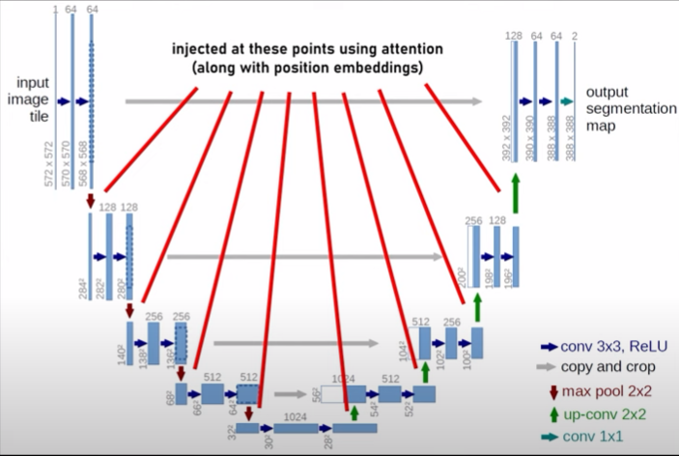
Self attention

